Slide 1
Biweekly Progress Update
20 Sep 2023

Slide 2
Project Title
Exploring CBDCs, Stablecoins, and Purpose-Bound Digital Currency: A Comparative Study and Interactive DApp

Slide 3
PROJect Description
Create CBDC e-commerce DApp to:
Use smart contracts to manage transactions efficiently and securely.
Allow users to load their CBDC into the wallet and then use it to make purchases on the e-commerce platforms.
Buy or sell stablecoins or pay by these cryptos (USDC, USDT, PYUSDC, etc.)
Lock certain fund for specific purpose by set it as Purpose Bound Money(PBM)
Earn rewards by redeeming for vouchers or discounts on participating event.
Notes:
savings, a charity donation, or a particular financial goal
spending, and rewards

Slide 4
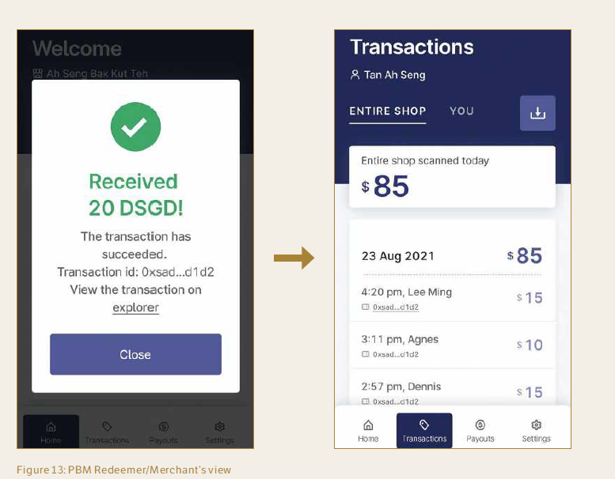
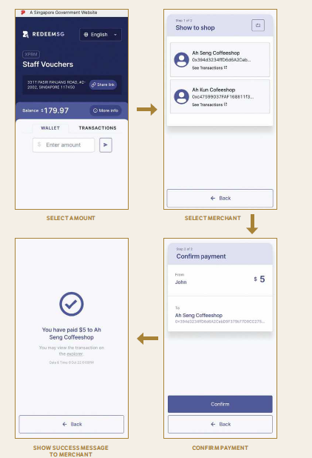
User’s Crypto Wallet
Merchant View

Slide 5
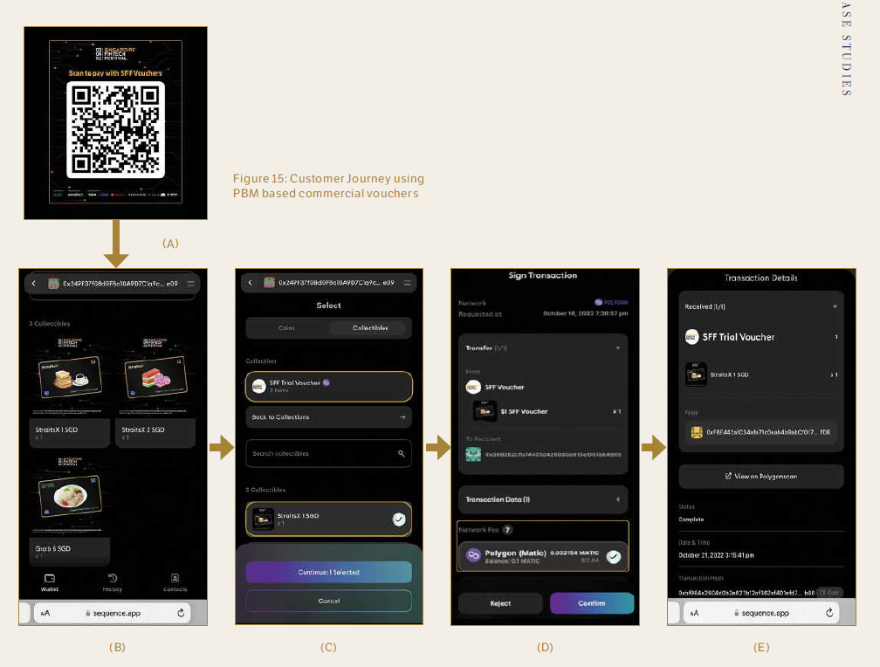
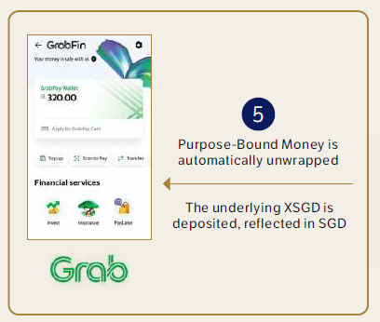
Singapore fintech festival
Notes:
a. Once attendees receive the PBMs,
they can view the PBMs in their
individual wallets.
b. Attendees can open the wallet to
scan the QR code.
c. The attendee selects the PBM to
be used.
d. Attendees review the wallet address,
selected PBM, network fee. Attendees
confirm the transaction.
e. PBM is successfully sent and accepted
into the merchant’s Grab wallet where
it will be automatically unwrapped into
XSGD and reflected in SGD.

Slide 6
Literature review
“Project Orchid.” Schemes and Initiatives. Singapore: Monetary Authority of Singapore, October 31, 2022. https://www.mas.gov.sg/schemes-and-initiatives/project-orchid.
“Purpose Bound Money (PBM) Technical Whitepaper.” Information Papers. Singapore: Monetary Authority of Singapore, June 21, 2023. https://www.mas.gov.sg/-/media/mas-media-library/development/fintech/pbm/pbm-technical-whitepaper.pdf.
Bansal, Rajesh, and Somya Singh. “China’s Digital Yuan: An Alternative to the Dollar-Dominated Financial System,” 40. 1779 Massachusetts Avenue NW Washington, DC 20036: Carnegie Endowment for International Peace, 2021.
Atlantic Council. “Central Bank Digital Currency Tracker.” Accessed September 13, 2023. https://www.atlanticcouncil.org/cbdctracker/.
Karam, Ayman Abi. “Central Bank Digital Currency (CBDC) and Blockchain Enable the Future of Payments.” IBM Blog (blog), August 17, 2023. https://www.ibm.com/blog/central-bank-digital-currency-cbdc-and-blockchain-enable-the-future-of-payments/.
“Project Dunbar - International Settlements Using Multi-CBDCs.” Research & Publication. BIS, Innovation Hub in partnership with the Reserve Bank of Australia, Central Bank of Malaysia, Monetary Authority of Singapore, and South African Reserve Bank, March 22, 2022. https://www.bis.org/publ/othp47.htm.
Chan, Elgin. “Renminbi Internationalisation: China’s Central Bank Digital Currency,” 2023. https://dr.ntu.edu.sg/handle/10356/165508

Slide 7
News and video
https://www.youtube.com/watch?v=Qrx_FnjRnfI
https://www.youtube.com/watch?v=9aXFeOsKndE&pp=ygUOY2JkYyBzaW5nYXBvcmU%3D
https://www.youtube.com/watch?v=PNkdlRPamPs&t=22s&pp=ygUOY2JkYyBzaW5nYXBvcmU%3D
https://youtu.be/Qrx_FnjRnfIrx_FnjRnfI (no English Subs)

Slide 8
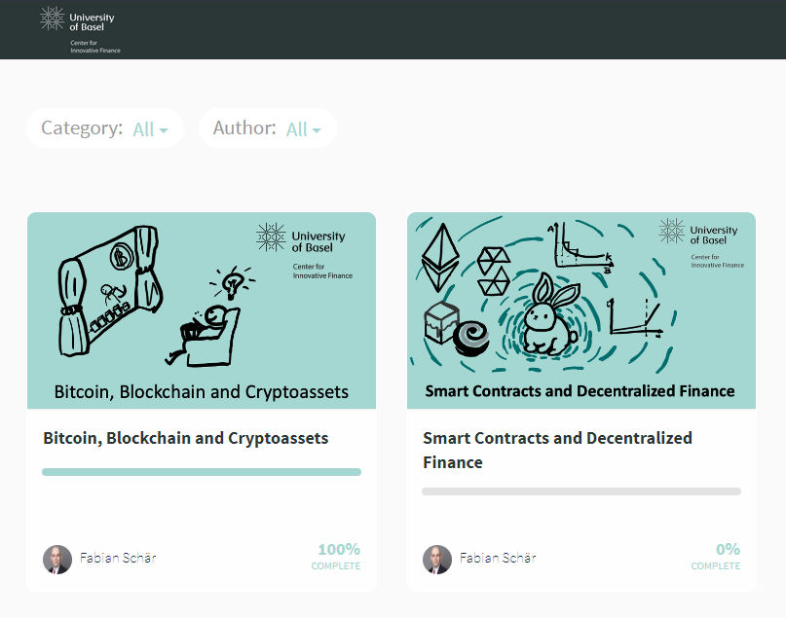
Learning
University of Basel
Bitcoin, Blockchain and Cryptoassets
Smart Contracts and Decentralized Finance
Notes:
Introduction
Welcome to the Class!
Monetary Theory Basics
Payment Systems
Monetary Control Structures
Bitcoin Primer
Transaction Capacity
Peer-to-Peer Networks
The Bitcoin Network
Introduction to Cryptography
Hash Functions
Symmetric Cryptography
Asymmetric Cryptography
Elliptic Curves and ECDSA
Exercise Set 1
Transaction Legitimacy
Transaction Overview
Bitcoin Script and Transaction Types
SigHash Types
Transaction Consensus
Block Assembly and Chain Structure
Proof-of-Work
Fork Theory
Incentives and Potential Attacks
Alternative Consensus Protocols
Exercise Set 2
Graded Exercise Set
Bitcoin as Money
The History of Digital Money
Pricing Models and Volatility
CBDCs and Stablecoins

Slide 9
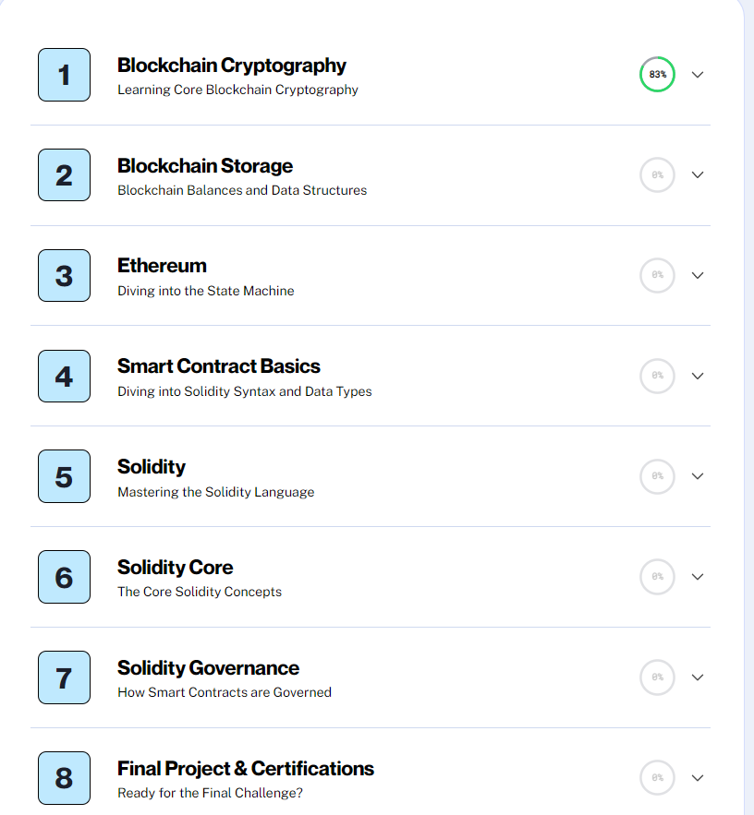
Learning
Alchemy University

Slide 10
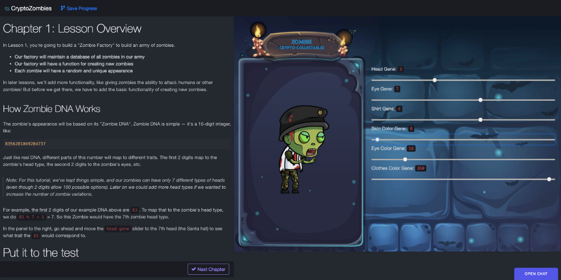
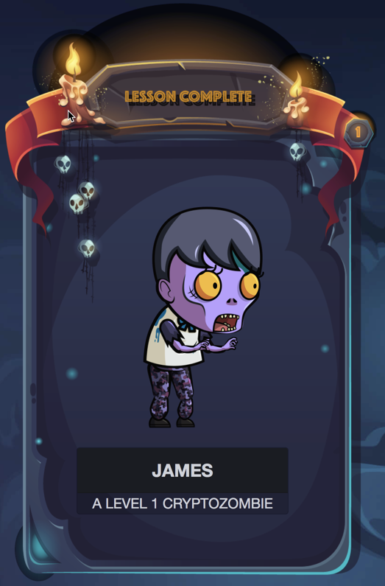
Learning
Crptozombies.io
Solidity: Beginner to Intermediate Smart Contracts
Advanced Solidity: Get In-depth Knowledge
Beyond Ethereum: Explore the Blockchain Ecosystem

Slide 11
Other useful resources
https://www.tutorialspoint.com/solidity/solidity_constructors.htm
https://docs.alchemy.com/docs/create-web3-dapp-quickstart
https://trufflesuite.com/guides/nft-rental-marketplace/
https://blog.cabala.co/how-i-set-up-my-local-solidity-development-environment-with-vscode-remix-and-truffle-suite-addd20ef9c
https://www.mas.gov.sg/-/media/mas/news/media-releases/2023/mas-stablecoin-regulatory-framework-infographic.pdf
https://github.com/norges-bank
https://github.com/Consensys/codefi-assets-and-payments
https://www3.ntu.edu.sg/home/ehchua/programming/blockchain/ethereum.html
https://github.com/codyseibert/web3-tickets

Slide 12
Thank you!

